Slide 1

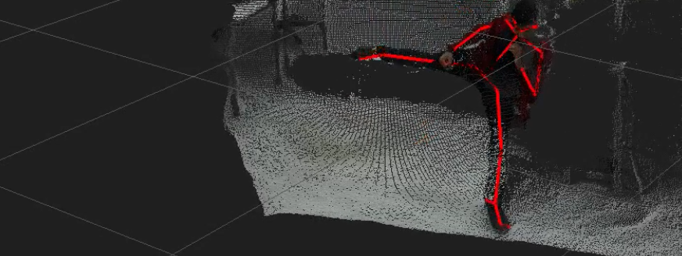
Risk Analysis based on Human posture recognition using skeleton
Aleksandr Adushev
Robotics Research Lab
Department of Computer Science
Technische Universität Kaiserslautern, Germany

Slide 2
Outline
Introduction
Methodology
Experiments and results
Conclusion
Future work

Slide 3
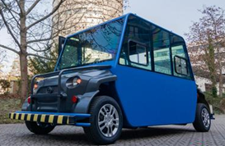
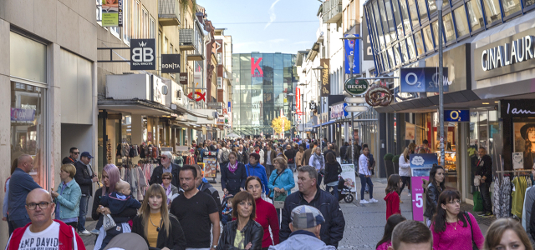
Introduction
Autonomous driving on pedestrian path
Too many pedestrians
Interaction
Understanding pedestrian using Skeleton from point cloud
Safely drive through pedestrians
Avoid confusion with pedestrians
Notes:
for interaction we need to know the postures

Slide 4
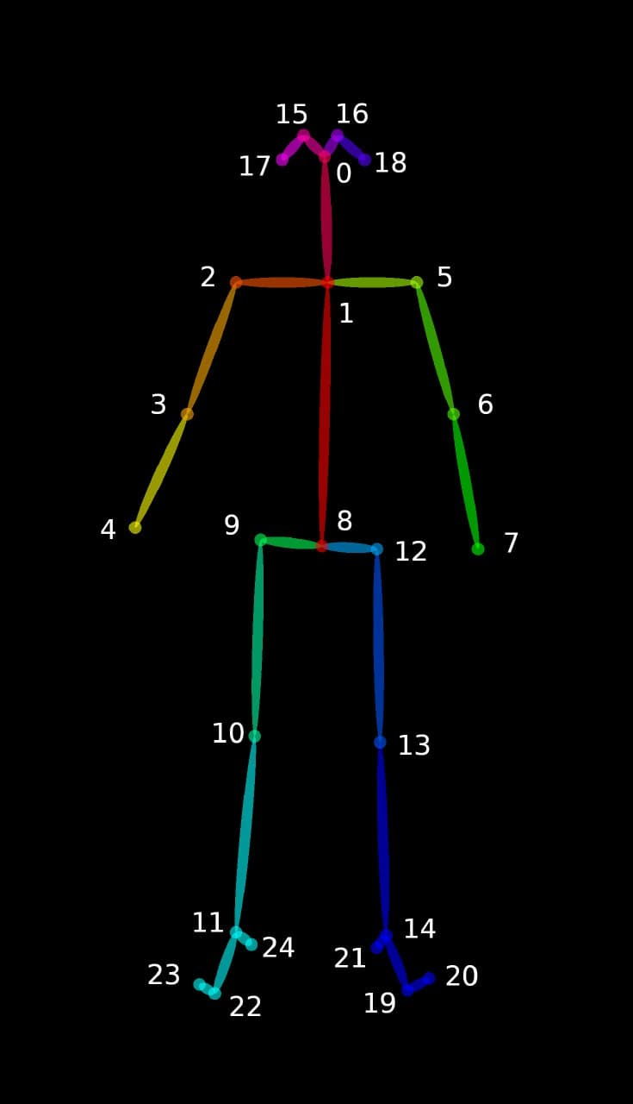
Methodology
Get point cloud
Build vectors using point coordinates
Calculate angles between vectors
Estimate posture based on angles
Risk analysis based on child, distance and awareness

Slide 5
Postures recognized
Standing
Sitting
Bending
Smart-phone Texting
Walking
Lying
Side Front/Back
Age
Gaze direction

Slide 6
Structure
Layer 1
Calculating angles and vectors
Layer 2
Fusing angles
Layer 3
Awareness
Layer 4
Risk analysis

Slide 7
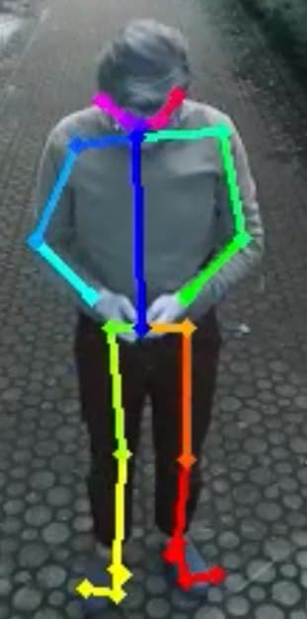
Smartphone texting posture requirements
0°<[Angle between temple and z axis]° <85°/15°
30° < [Elbow angle]° < 150° / 60°
Looking down fusion is a maximum fusion of left and right temple angles
Arms folding is a maximum fusion of left and right elbow angles
Smartphone texting is a weighted average fusion of looking down, stimulated by arms folding

Slide 8
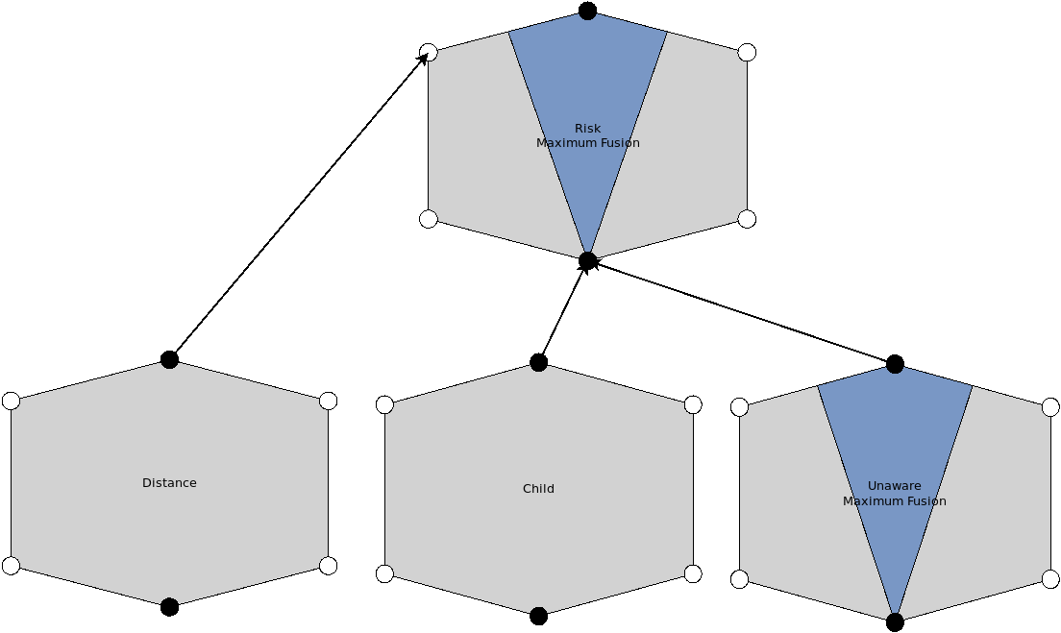
Risk Calculation
Risk is a situation involving exposure to danger
Our case: collision with vehicle
Main idea
Check how much aware pedestrian is about a vehicle
Check presents of child

Slide 9
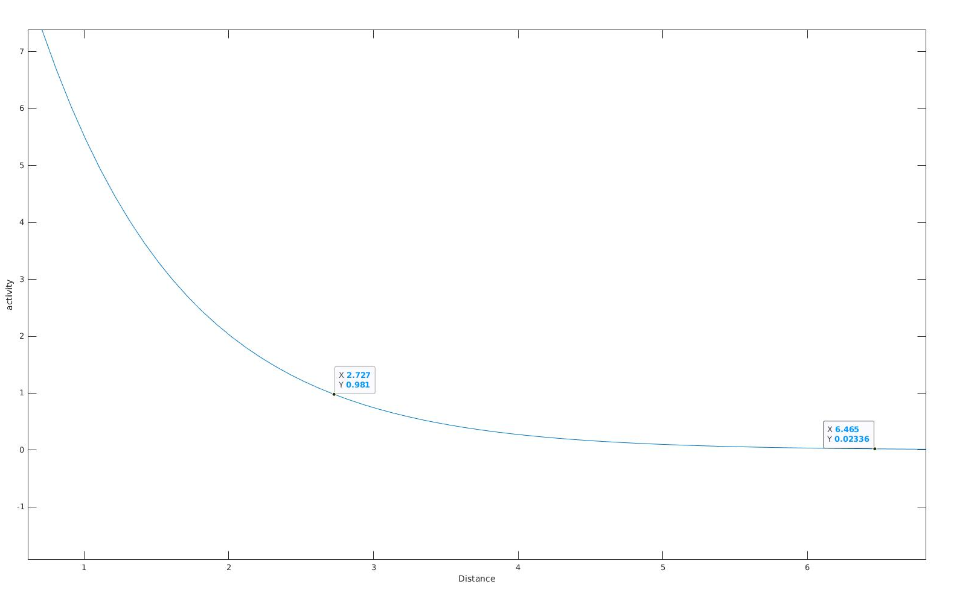

Risk parameters
Parameters
Distance to Vehicle
Unaware Behavior
Looking other direction
Back side
Sitting
Smart Phone texting
Child
Standing position
10 cm < Distance between feet and chest < 70 cm
S — the safe distance, P — scalar parameter, D — the distance between the camera and a person

Slide 10
Experiments and Results
Postures

Slide 11
Experiments and Results
Pedestrian Approaching

Slide 12
Experiments and Results
Pedestrian Approaching and Texting Smartphone

Slide 13
Experiments and Results
Pedestrian Leaving

Slide 14
Experiments and Results
4 Pedestrians Activity

Slide 15
Conclusion
Accurate postures using 3D skeleton data
Easy to combine postures using IB2C
Can be implemented for large crowd
Extendable to cyclist posture
Occlusion problem

Slide 16
Thank You

